Slide 1

SIG activity reports
Topics SIG lunch meeting
Hyderabad - September 4th
Interspeech 2018

Slide 2

SIG objectives (1)
Structure sub-communities and address specific scientific or language topics
  13 Topic SIGs and 6 language SIGs: http://www.isca-speech.org/iscaweb/index.php/sigs
  SIG pages updated by GB
    please keep me informed!!
    Maintain a SIG-website and discussion list
  Means: workshops, challenges, training schools, discussion lists, special issues, etc
SIG, workshop committee and workshop organizers
  ISCA endorsement & workshop applications: promoting, archiving, indexing & referencing, etc
  Scientific policy, treasures, survey of international scientific committees: long-term prospective/perspective

Slide 3
SIG objectives (2)
Interfaces with other disciplines
  Examples of WOCCI with ICMI, AVSP with FAA, etc
  Joint affiliations with IEEE, ACM & ELRA
  JEP/TAL, AISV/Voice
Bridging inside
  HIST with speech
  technology,
  SIGML & RoSP,
  CHILD & SLaTE,
  etc…
New SIGs
  Speech production?
…
Affective computing
Machine
Learning
SPro
Computer Graphics
SIGML
ISCA
Interspeech
AVISA
Human-Computer
Interaction
CHILD
SLaTE
SIGdial
Educational
Sciences
Natural language processing

Slide 4
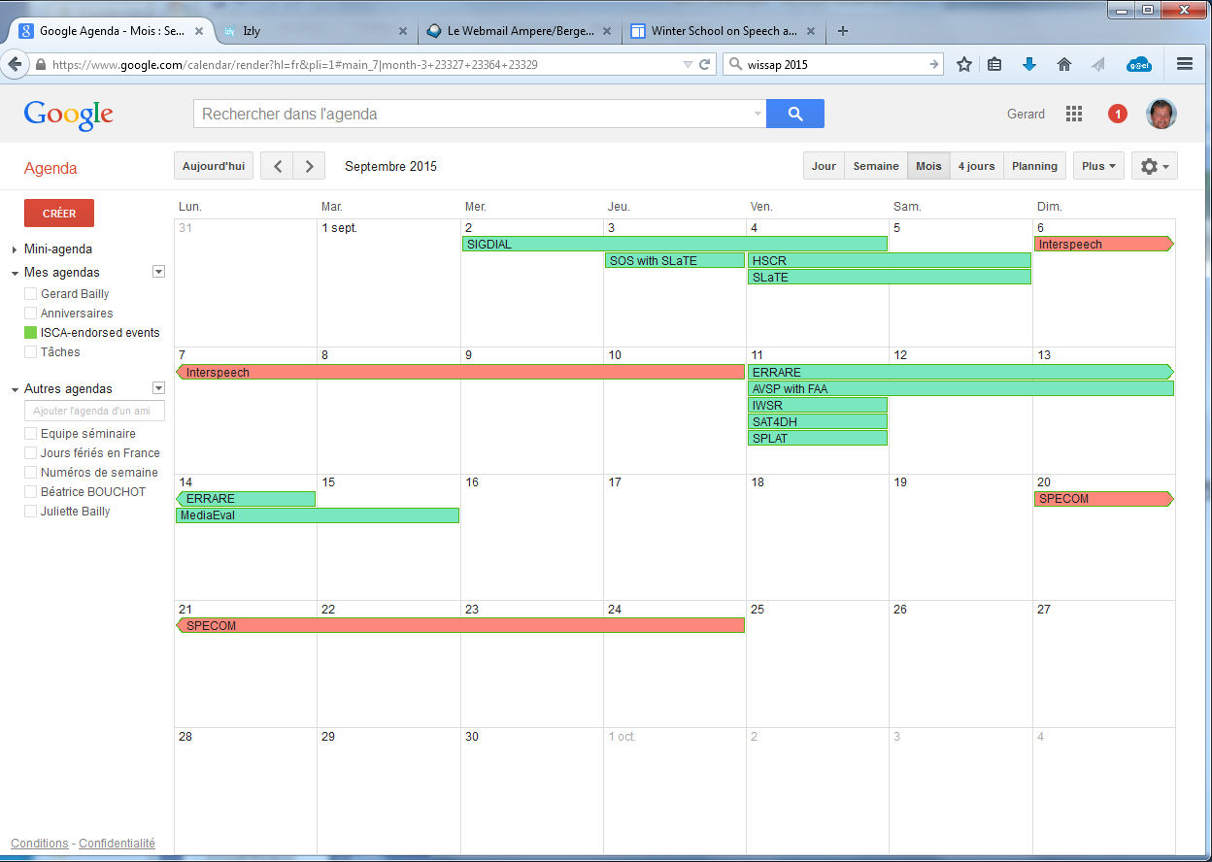
SIG & workshops
SIG committee: 2 members of the ISCA board + SIG liaisons
Workshop committee: 4 members of the ISCA board + 3 last chairs of IS satellite workshops
  Examine applications for ISCA endorsement of
    ITRW, ISCA sponsored vs. supported events & Challenges

Slide 5
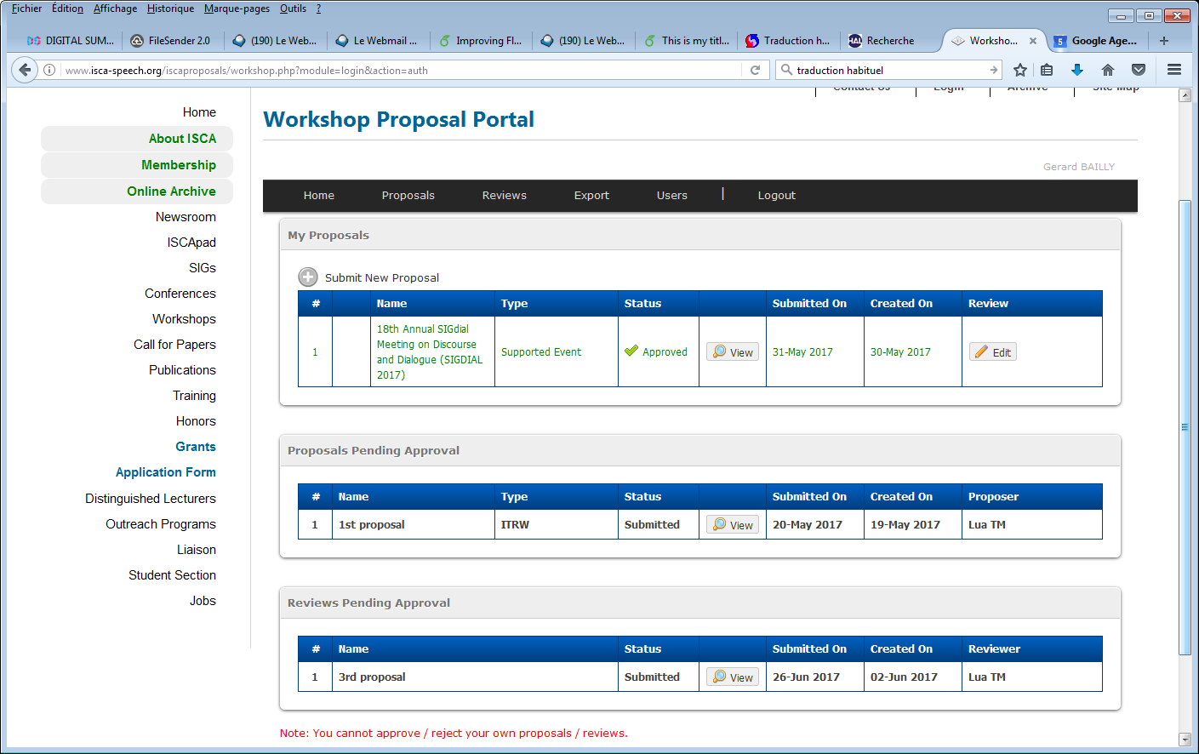
SIG & workshops news
Workshop application portal
  All workshops fill an application!! Even those endorsed by SIGs
  Post-event reports
  Sponsorship limited to 800€ per event (travel grant for one invited speaker)
  Link with grant portal: perquisite for student travel grants
    Only 5 applications in 2017 (vs. 65 for IS) and 1 in 2018!!! Please advertise!!!

Slide 6
Workshops 2018
  22 ISCA-endorsed events in 2018
  Record number: TAL, Odyssey, AI-MHRI, SLTU, SMM, ML-SLP, CHiME, P-HindE, SP-VSHD, SPICE, Speech Prod, SPECOM, SAP, INLG, IberSpeech, ISCSLP
  New themes: Speech, Music & Mind, English in India
  6 IS satellites, 1 challenge (Blizzard)
  Gathering 2240 attendees
  8300€ for invited speakers
  5100€ for training schools

Slide 7
Topic-SIGs

Slide 8
Robust Speech Processing SIG
https://wiki.inria.fr/rosp/
Number of members stable to ~140
Organized in 2018:
  5th CHiME Challenge
    50h distant-mic conversational speech collected in real homes
    $80,000 cost fully sponsored by Google + Kinects by Microsoft
    launched in March, data licensed to ~400 people
    hope to raise money through an industry license in order to fund a future challenge
  CHiME 2018 Workshop
    on Friday at Microsoft Hyderabad
    ~100 people
    challenge results to be announced

Slide 9
Robust Speech Processing SIG
https://wiki.inria.fr/rosp/
Forthcoming election: E. Vincent to resign
Currently preparing new challenges for 2019–2020:
  CHiME-6 challenge based on the CHiME-5 data, may involve diarization in addition to ASR + workshop at NIPS 2019
  paralinguistic challenge based on the CHiME-5 data (sponsorship still under discussion for annotation)
  robot ASR challenge?
Keep repository of publicly available resources up to date

Slide 10
SIG UNDER-RESOURCED LANGUAGES
Joint Special Interest Group
  International Speech Communication Association (ISCA)
  European Language Resources Association (ELRA)
  (SaLTMil members have approved the creation of SIGUL)
Main objectives
  Supports linguistic diversity through technology and ICT
  Commits to increase the lesser-resourced languages (regional, minority, or endangered) chances to survive the digital world
Board (after elections end of 2017)
  Chair and ELRA liaison representative: Claudia Soria (CNR-ILC, Pisa, Italy)
  Co-chair and ISCA liaison representative: Laurent Besacier (LIG, France)
  Secretary: Sakriani Sakti (NAIST, Nara, Japan)
  Contributor: Dorothee Beerman (NTNU, Norway)

Slide 11
SIGUL 2018 Activities
Start over the SIG recently created
  Mainling list: sigul@list.elra.info (>200 members)
  Web page: http://www.elra.info/en/sig/sigul/
  International advisory group
LREC 2018 Satellite Workshop (May 2018)
  “Collaboration and Computing for Under-Resourced LanguagesTowards an Alliance for Digital Language Diversity (CCURL)”
  Miyazaki, Japan
  1 keynote, 15 papers, 30 participants – proceedings now online http://lrec-conf.org/workshops/lrec2018/W26/
INTERSPEECH 2018 Satellite Workshop (September 2018):
  “Workshop on Spoken Language Technologies for Under-Resourced Languages (SLTU)”
  New Dehli, India
  72 papers submitted (removing out-of-domain) ; half from India+SAARC ; 54 papers accepted
  Program
- Tutorial: August 29th, 2018 (2 Parallel Tutorials for ASR and NMT)
- Main Conference: August 30th-31st, 2018 – 2 keynote speakers (E. Dupoux and P. Bhattacharyya)

Slide 12
SIGUL 2019 Plans
ICPhS 2019
  Special session accepted at ICPhS 2019 (Melbourne, Australia)
  Computational Approaches for Documenting and Analyzing Oral Languages
  Attracting computer scientists to ICPhS and engaging them in discussions with phoneticians (and linguists generally)
  http://lig-getalp.imag.fr/icphs-2019-special-session/
UNESCO 2019 International Year of Indigeneous Languages
  Local workshops for the creation of digital language resources for indigeneous languages
    Opportunities in Uganda and/or Ghana (Dorothee Beerman)
Zero Speech Challenge 2019
  To be confirmed and set up

Slide 13
SLPAT (speech and language processing for assistive technologies)
This year (2018)
Over 120 members (some of them here:).
  https://groups.google.com/forum/#!forum/sig-slpat
Elections held last Fall. Executives:
  President: Frank Rudzicz Vice-President: Heidi Christensen
  Secretary-Treasurer: Emily Prud'hommeaux
  Student representativ: Stefania Raimondo
By the SIG’s suggestion, we’re taking this year ‘off’.
Notes:
Interspeech 1 of 6
TACCESS special issue…

Slide 14
SLPAT (speech and language processing for assistive technologies)
Next year (2019)
We will be holding our workshop at the 57th Annual Meeting of the Association for Computational Linguistics (ACL) in Florence.
Since we will be co-located with BioNLP and CLPsych, we have had preliminary discussions as to how to foster collaboration across these health-related workshops.
We have been speaking with a Frontiers journal about another special issue.
Notes:
Interspeech 1 of 6
TACCESS special issue…

Slide 15

Speech Prosody Special Interest Group
Last Speech Prosody meeting: 2018 at Adam Mickiewicz University, Poznań, Poland, June 13-16, 2018
  No USB proceedings. Online proceedings at ISCA archive
Three candidates for next Speech Prosody meeting (2020)
  Tokyo, Japan Sonderborg, Denmark Maceió, Alagoas, Brazil
Currently 1082 registered members, listed at http://sprosig.org/members
Constitution available on line at http://sprosig.org
Notes:
Interspeech 1 of 6
TACCESS special issue…

Slide 16
Speech Prosody Special Interest Group
Officer elections held biennially. Next term: from October 2018.
Officers are permitted to hold office for up to four terms (8 years). Current officers must be replaced in 2018.
  Election of new officers is on the way as of July 11.
Current officers (Until September 2018):
  President: Keikichi Hirose
  Liaison: Yi Xu
  Secretary: Mark Hasegawa-Johnson
  Treasurer/New Conferences: Hansjoerg Mixdorff
Officers report to a Permanent Advisory Committee, including
  Permanent members: Hirst, Bel, Campbell, Fujisaki
  Current officers: Hirose, Xu, Hasegawa-Johnson, Mixdorff
  Speech Prosody organizers, for 10 years following date of the conference.
Notes:
Interspeech 1 of 6
TACCESS special issue…

Slide 17
My SIG outcomes - 1
SSW10 in 2019
  86 votes to choose location
  SSW10 will be held in Vienna
    Chairman: Dr. Michale Pucher (Academy of Science)
    20-22 September, 2019
    Location: Austrian museum of folk life

Slide 18
My SIG outcomes - 2
SSW10 in 2019
  Sponsors : Apple (confirmed), Google (approached)
  Confirmed Keynotes: Aaron van den Oord (Google DeepMind, ML), Claire Gardent (LORIA, NLP)
  Proposal to ISCA will be submitted shortly
Special session on voice conversion at Speaker Odyssey 2018
  Voice conversion is ”popular” in Speaker Recognition
  Special session on voice conversion challenge at the Odyssey 2018 Workshop held by SpLC
Update SynSIG webpages
  Update contents and pointers

Slide 19
My SIG plans
Plans related to SSW 10
  Arrange submission and review systems
  Arrange special events for 10th anniversary of SSW
  Record oral presentations for superlectures.com
  Introduce best paper awards and best student paper award to improve the quality of papers
  Propose a special issue to CSL/SpeCom
Other plan
  Interact with “the summer school course in Crete Speech Processing Courses in Crete – Towards Flexible and Intelligible End-to-End Speech synthesis systems”
  Video archive
  Improve resource management

Slide 20

SLaTE - past
2017 – secretary: Keelan Evanini
email list – now a Google group – updated: 104 members
SLaTE 2017, Stockholm, a 2-day workshop (like Leipzig 2015, previous workshops were 3 days)
  60 attendees, 36 accepted papers
  Presentations: 22 oral, 10 poster, 6 demos
  Special Sessions: Educational robots & CALL shared task
Baur, Gerlach, Rayner, Russell, Strik + Chua, Wei + Caines
  https://regulus.unige.ch/spokencallsharedtask/
  A Shared Task for Spoken CALL: Paper at LREC-2016, Special sessions at SLaTE 2017 & Interspeech 2018
Notes:
The special poster session on ‘L1 Teaching, Learning and Technology’ was originally intended to be a satellite of SLaTE.
The aim of a 1-day SoS (Satellite of a Satellite) workshop is to bridge the gap between researchers in education and researchers in speech and text processing technology by organising a joint event where researchers from one workshop are able to visit the other workshop to get an idea of the respective positions on the state of the art on the topic of language and technology in education.
SLaTE questionnairre. This was instigated as a consequence of discussions at SLaTE 2013. Completed questionnairres were returned by 34 people. Preference for 2 days workshops. Make available online? Could it be attached to the ISCA SLaTE webpage?
The SLaTE email list has been overhauled. Dead addresses have been removed and new people added. Currently contains 315 addresses.
Plans for SLaTE 2017 were presented at SLaTE 2015. SLaTE 2017 will be a satellite of Interspeech 2017 near Stockholm. Particularly appropriate for 10 year anniversary of SLaTE in 2017 because of origins of SLaTE in 1998 Marholmen STiLL workshop
New officers elected at SLaTE 2015,

Slide 21
SLaTE - Future
Spoken CALL Shared Task
  3rd edition? New task - challenge?
SLaTE 2019, satellite of Interspeech 2019 Graz
Try to involve junior researchers more, e.g. MA & PhD students, early post-docs
Notes:
The special poster session on ‘L1 Teaching, Learning and Technology’ was originally intended to be a satellite of SLaTE.
The aim of a 1-day SoS (Satellite of a Satellite) workshop is to bridge the gap between researchers in education and researchers in speech and text processing technology by organising a joint event where researchers from one workshop are able to visit the other workshop to get an idea of the respective positions on the state of the art on the topic of language and technology in education.
SLaTE questionnairre. This was instigated as a consequence of discussions at SLaTE 2013. Completed questionnairres were returned by 34 people. Preference for 2 days workshops. Make available online? Could it be attached to the ISCA SLaTE webpage?
The SLaTE email list has been overhauled. Dead addresses have been removed and new people added. Currently contains 315 addresses.
Plans for SLaTE 2017 were presented at SLaTE 2015. SLaTE 2017 will be a satellite of Interspeech 2017 near Stockholm. Particularly appropriate for 10 year anniversary of SLaTE in 2017 because of origins of SLaTE in 1998 Marholmen STiLL workshop
New officers elected at SLaTE 2015,

Slide 22

AVISA
Activities of the past year
Continuing social media presence - AVSP twitter account –@AV_SP now 684 followers
Organized AVSP 2017 in Sweden (Interspeech satellite conference) – continued the low-cost format – about 50 people attended
Organized “Remembering Eric Vatikiotis-Bateson”. Special session at AVSP and recollection “Eric Vatikiotis-Bateson and the Birth of AVSP” – in process of having highlights posted on the AVISA web site

Slide 23
AVISA Plans
Forthcoming activities:
AVSP 2019 – looking into having a conference in Melbourne as satellite to ICphS 2019 which will be held on the 5th-9th August, 2019
Continuing to expand the AVISA web site

Slide 24
SIG-CHILD
SIG-CHILD: Special Interest Group on Child Computer Interaction
Motivation: SIG-CHILD aims to bring together researchers and practitioners from universities and industry working in all aspects of multimodal child-machine interaction with a particular emphasis on, but not limited to, speech interactive interfaces.
Board members:
  Chairperson: Keelan Evanini (Educational Testing Service)
  Secretaries: Maryam Najafian (CSAIL Lab, MIT), Saeid Safavi (University of Surrey)
  Past chair advisory: Kay Berkling (DHBW)
SIG-CHILD mailing list (81 members)

Slide 25
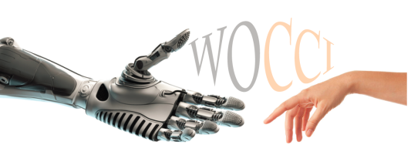
SIG-CHILD activities
WOCCI 2017: Workshop on Child Computer Interaction
  workshop at ICMI 2017, International Conference on Multimodal Interaction
  November 13, 2017 in Glasgow, Scotland
  invited speaker: Martin Russell (University of Birmingham)
  11 papers, 18 attendees
  proceedings available in ISCA archive
upcoming plans
  WOCCI 2019 (special session at Interspeech 2019 in Graz)
  shared task on children’s ASR

Slide 26
SIGML Outcomes 2018
MLSLP 2018
  September 7, 2018, Hyderabad.
  https://sites.google.com/view/mlslp/home
  General Chairs: Preethi Jyothi, Rohit Prabhavalkar
  Program Chairs: Liang Lu, Tara Sainath
  Local Organizer: Negar Saei
  Registration opened 7/9, and closed 7/15 because the room is full.
Officer Elections
  Nominations are open through September 2018
  Elections will be held by e-mail during October 2018
  Two current officers are not eligible for re-election (have served 8 years). One has served two years, is therefore eligible for re-election.

Slide 27
SIGML Plans 2018
Traditionally, MLSLP alternates between
  ICML co-location: 2011, 2017, (2019?)
  Interspeech co-location: 2012, 2016, 2018
MLSLP 2019
  Possibly co-locate with ICML 2019, Long Beach, CA, 6/10-15.
  Local organizing committee not yet recruited
Scientific Committee of MLSLP
  2016: 16 members (8 accepted papers)
  2017: 13 members (5 accepted papers)
  2018: 13 Members (13 accepted papers, of 30 submissions)

Slide 28
SIGDial Exec, SAC & members
Last election February 2017 (plus bi-election November 2017), board is now:
President: Jason Williams, Apple
Vice-President: Kallirroi Georgila, USC ICT
Treasurer: Ethan Selfridge, Interactions Corp
Secretary: Vikram Ramanarayanan, ETS
Scientific Advisory Committee (SIGDIAL board): Annie Louis, Ryuchiro Higashinaka, Milica Gasic, Barbara Di Eugenio, Kai Yu, Gabriel Skantze
Liaisons: Sebastian Moeller (ISCA), Raquel Fernandez & David Schlangen (SEMDIAL), Satoshi Nakamura (IEEE SLTC), Kotaro Funakoshi (SIG-SLUD), Candace Sidner (IUI), Alex Rudnicky (AVIOS), Kristiina Jokinen (IWSDS), Dan Bohus (ICMI), John Langford (ICML), Antoine Bordes (NIPS/ICLR)
President Emeritus: Amanda Stent
Members: 581
Website: http://www.sigdial.org
Mailing List: http://sigdial.org/content/mailing-list-administration

Slide 29
SIGdial Functions and Activities
To promote interest in discourse and dialogue processing
  Focal event: SIGDIAL Conference annual meeting (12-14 /7/2018, Melbourne)
  Next event: SIGDIAL 2019, Stockholm, Sweden (immediately before/after INTERSPEECH)
  Develop the field: Annual Young Researchers’ Roundtable on Spoken Dialog Systems (YRRSDS); student travel grants to SIGDIAL and endorsed events
  Liaise with ISCA, ACL and AAAI
To facilitate the exchange of research developments in the field:
  Maintain an active mailing list http://sigdial.org/content/mailing-list-administration
  Produce videos and archive SIGDIAL presentations
  Provide mentoring for accepted SIGDIAL papers
To endorse high-quality events in the field
  Endorse events: SemDial, workshops, etc.
  Endorse journals: Discourse and Dialog

Slide 30


Speech and Language in Multimedia
ISCA Special Interest Group http://slim-sig.irisa.fr
MediaEval 2018:
  Strategy: In 2017-2018, SIG SLIM focused on expanding interest in spoken content search by pushing for new tasks within MediaEval.
  Result: “Eyes and Ears Together” is a new multimodal spoken content task to be presented at the MediaEval 2018 Workshop 29-31 Oct., Sophia Antipolis, France.
Moving forward:
  Leadership: We anticipate a change of SIG leadership after Interspeech 2018, with Martha Larson/TU Delft stepping into the foreground.
  Revival: Previously, the SIG was shrinking. No spoken content search tasks or events were organized and the outlook was bleak. However, according to industry, podcasting is experiencing a third wave, offering promise for successful revival of SIG SLIM in 2019.
  Recent: Martha Larson and Gareth Jones were invited speakers at the KDD Workshop on Machine Learning and Data Mining for Podcasts in London on 20 August 2018.
Martha Larson, Radboud University & TU Delft
Gareth Jones, Dublin City University
Guillaume Gravier, CNRS, IRISA
Notes:
http://multimediaeval.org
http://smalldata.io/kdd2018

Slide 31
Langage-SIGs

Slide 32
AFCP
Association Francophone de la Communication Parlée:
French non-profit association since 2001
Aim: association for the support, development, dissemination and promotion of speech sciences and technology in the French-speaking community
Board elected every 4 years
(16 members, on-going: 2017—2020)
  Chairman: Véronique Delvaux
  Vice-Chairman: Martine Adda-Decker
  Treasurer : Yohann Meynadier (vice-tr: Camille Fauth)
  Secretary : Emmanuel Ferragne, (vice-secr: Thomas Pellegrini)
June 2018: 158 members including 35 % of students and 12% out of France

Slide 33
AFCP outcomes & plans
Financial and scientific sponsorship
  Award for the best dissertation (every 2 years)
    Latest: Ivana Didirkova (Praxiling, Montpellier): “Parole, langues et disfluences: une étude linguistique et phonétique du bégaiement”, 2017-2018
  Financial support for the Christian Benoît award (Henceforth ISCA)
  Support for the organization of scientific events
    7th Journées de Phonétique Clinique, Paris, 2017
    15th RFP Meeting (Réseau Français de Phonologie), Grenoble, 2017
    Workshop « Linguistics and Big Data », Paris-Orsay, 2017
    Summerschool « Big data and speech », Roscoff, 2018
    Speaker Odyssey, Les Sables d’Olonne, 2018
    Ateliers Science et Voix, Grenoble, 2017-2018
  Travel grants for students & postdocs
    2016: 15 grants

Slide 34
AFCP outcomes & plans
Main conference: Journées d’Etude sur la Parole JEP
  Every 2 years,
  1 time in 2 (every 4 years): joint organization: JEP-TALN (main conference of ATALA, the French Association for Natural Language Processing)
  Latest: 32th JEP 2018: Laboratoire Parole & Langage (LPL), Aix-en-Provence; around 100 papers and 150 participants
Community animation
  AFCP Training days; latest: ‘Statistiques et données phonétiques atypiques’, 2017, Paris
  Mailing List: « parole », web site, social networks
  Science/Society issues (Forensic phonetics, Artificial intelligence, Standards of scientific communication, etc.)
  Joint initiatives (European General Data Protection Regulation, safeguarding of instrumental phonetics heritage, etc.)

Slide 35

2018 – Activities
January 2018 – Annual Conference (Trento)
  ~70 participants
  ~40 papers & posters
  Proceedings post-processed and published on January 2019
New committee and new website for Italian Phorensic Phonetics Group within AISV (tba)
Call for scholarships for young researchers summer activities
AISV publishing activities
October 2018
  AISV organizes a satelite event to the CLARIN conference:
  Spam - Speech In The Age Of Multimodal Humanities
  http://smart.sns.it/multimodal_speech
  New elections call
December 2018
  End of 3-year term for present AISV board and President
Notes:
L’AISV ha circa 100 iscritti, circa 60-70 stabili e un numero aggiuntivo variabile dipendente dagli iscritti alle conferenze che automaticamente sono soci della associazione per almeno un anno. La conferenza annuale è il momento più
importante per l’associazione, momento nel quale si tiene l’assemblea dei soci, si approva il bilancio e si stabiliscono le linee guida per le attività dell’anno successivo.
L’AISV ha al suo interno uno special interest group dedicato alla fonetica forense che aveva negli anni scorsi rallentato le sue attività. Il board dell’AISV ha nominato una nuova commissione per riavviare le sue attività. Il nuovo board è composto da Luciano Romito, Mirko Grimaldi, Silvia Calamai, Vincenzo Galatà, con la supervisione del presidente dell’AISV, Franco Cutugno.
Abbiamo, come facciamo da anni, contribuito con dei modesti gettoni di presenza erogati a 5 studenti alle attività dei nostri giovani ricercatori per partecipazione a scuole estive e convegni internazionali (ma su questo ne sai tu più di me).
Nel prossimo mese di ottobre si terrà a Pisa la conferenza annuale di CLARIN, l’AISV ha organizzato un evento satellite di cui i co-chair sono Chiara Celata e il nostro presidente.
Il consiglio direttivo e il presidente terminano il loro triennio di lavoro alla fine del 2018, abbiamo pertanto lanciato una call per le candidature a far parte del prossimo board, abbiamo 6 candidati, che hanno anche presentato alcune note programmatiche, le elezioni saranno condotte nel mese di ottobre, il nuovo consiglio si insedierà a gennaio 2019 e al suo interno individuerà il nuovo presidente.
The AISV has about 100 members, about 60-70 stable and an additional variable number dependent on the members of the conferences that automatically are members of the association for at least a year. The annual conference is the most time important for the association, when the shareholders' meeting is held, the financial statements are approved and the guidelines for the activities of the following year are established. The AISV has within it a special interest group dedicated to the forensic phonetics that in recent years had slowed down its activities. The AISV board has appointed a new commission to restart its activities. The new board is composed of Luciano Romito, Mirko Grimaldi, Silvia Calamai, Vincenzo Galatà, with the supervision of the president of the AISV, Franco Cutugno. We have, as we have been doing for years, contributed with modest attendance fees paid to 5 students to the activities of our young researchers for participation in summer schools and international conferences (but on this you know more than me). In the month of October the annual CLARIN conference will be held in Pisa, the AISV has organized a satellite event of which the co-chairs are Chiara Celata and our president. The board of directors and the president finish their three years of work at the end of 2018, we have therefore launched a call for nominations to be part of the next board, we have 6 candidates, who also presented some programmatic notes, the elections will be conducted in the month in October, the new council will be installed in January 2019 and will identify the new president.

Slide 36
2019 – Activities
New board and President elected
February – Annual Conference in Arezzo (Tuscany)
  https://www.aisv.it/aisv2019/en/
  Proposed theme: Audio Archives At The Crossroads Of Speech Sciences, Digital Humanities And Digital Heritage
  Invited Speakers (provisional): Franciska de Jong
  Special session (supported by CLARIN ERIC) with Christoph Draxler
June: Phonetics and Phonology in Europe (PaPE 2019)
  Mon 17-Tue 18-Wed 19 June 2019 (Lecce)
  http://pape2019.unisalento.it
Call for (small) scholarships for young researchers’ summer activities (with preference for PaPE 2019 participation)
Notes:
Su questa non c’è molto da aggiungere rispetto a quanto leggi nella slide, del resto su pape ne sai piu di me.

Slide 37
Discussions
Workshops
  IS satellites: too many? Difficult to choose between overlapping dates? Competing with IS sessions?
  Partnership with other associations/workshop series (e.g. WOCCI + ICMI): pros (SIG at frontiers) vs. cons (drop-outs of regular attendees, copyrights)
  Avoid workshops with no ISCA endorsement
SIG treasures, workshop cash-flows
New SIGs
  NoLISP, speech production, phonetics, brain studies?

