Slide 1

SIG activity reports
Topics SIG lunch meeting
Graz - September 17th
Interspeech 2019

Slide 2

SIG objectives (1)
Structure sub-communities and address specific scientific or language topics
  13 Topic SIGs and 6 language SIGs: http://www.isca-speech.org/iscaweb/index.php/sigs
  SIG pages updated by GB
    please keep me informed!!
    Maintain a SIG-website and discussion list
  Means: workshops, challenges, training schools, discussion lists, special issues, etc
SIG, workshop committee and workshop organizers
  ISCA endorsement & workshop applications: promoting, archiving, indexing & referencing, etc
  Scientific policy, treasures, survey of international scientific committees: long-term prospective/perspective

Slide 3
SIG objectives (2)
Interfaces with other disciplines
  Examples of WOCCI with ICMI, AVSP with FAA, etc
  Joint affiliations with IEEE, ACM & ELRA
  JEP/TAL, AISV/Voice
Bridging inside
  HIST with speech
  technology,
  SIGML & RoSP,
  CHILD & SLaTE,
  etc…
New SIGs
  SIGUL (launched 2017)
  SPSC (launched 2019)
  Speech production?
…
Affective computing
Machine
Learning
SPro
Computer Graphics
SIGML
ISCA
Interspeech
AVISA
Human-Computer
Interaction
CHILD
SLaTE
SIGdial
Educational
Sciences
Natural language processing

Slide 4
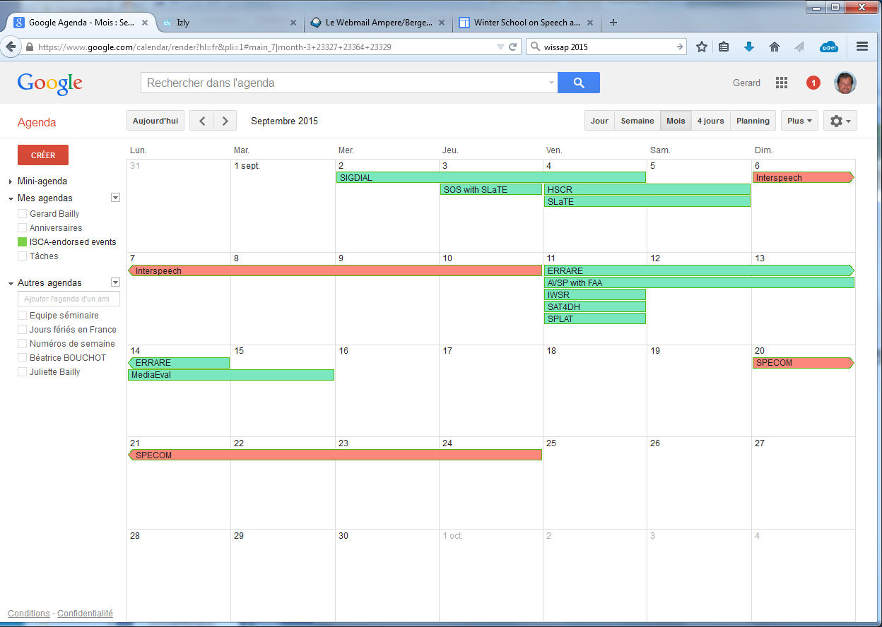
SIG & workshops
SIG committee: 2 members of the ISCA board (GB, PG) + SIG liaisons
Workshop committee: 4 members of the ISCA board (GB, PG, TS) + 3 last chairs of IS satellite workshops
  Examine applications for ISCA endorsement of
    ITRW, ISCA sponsored vs. supported events & Challenges
Events calendar: eujs62hcrc1ohga6nt5jc7b2t4@group.calendar.google.com

Slide 5
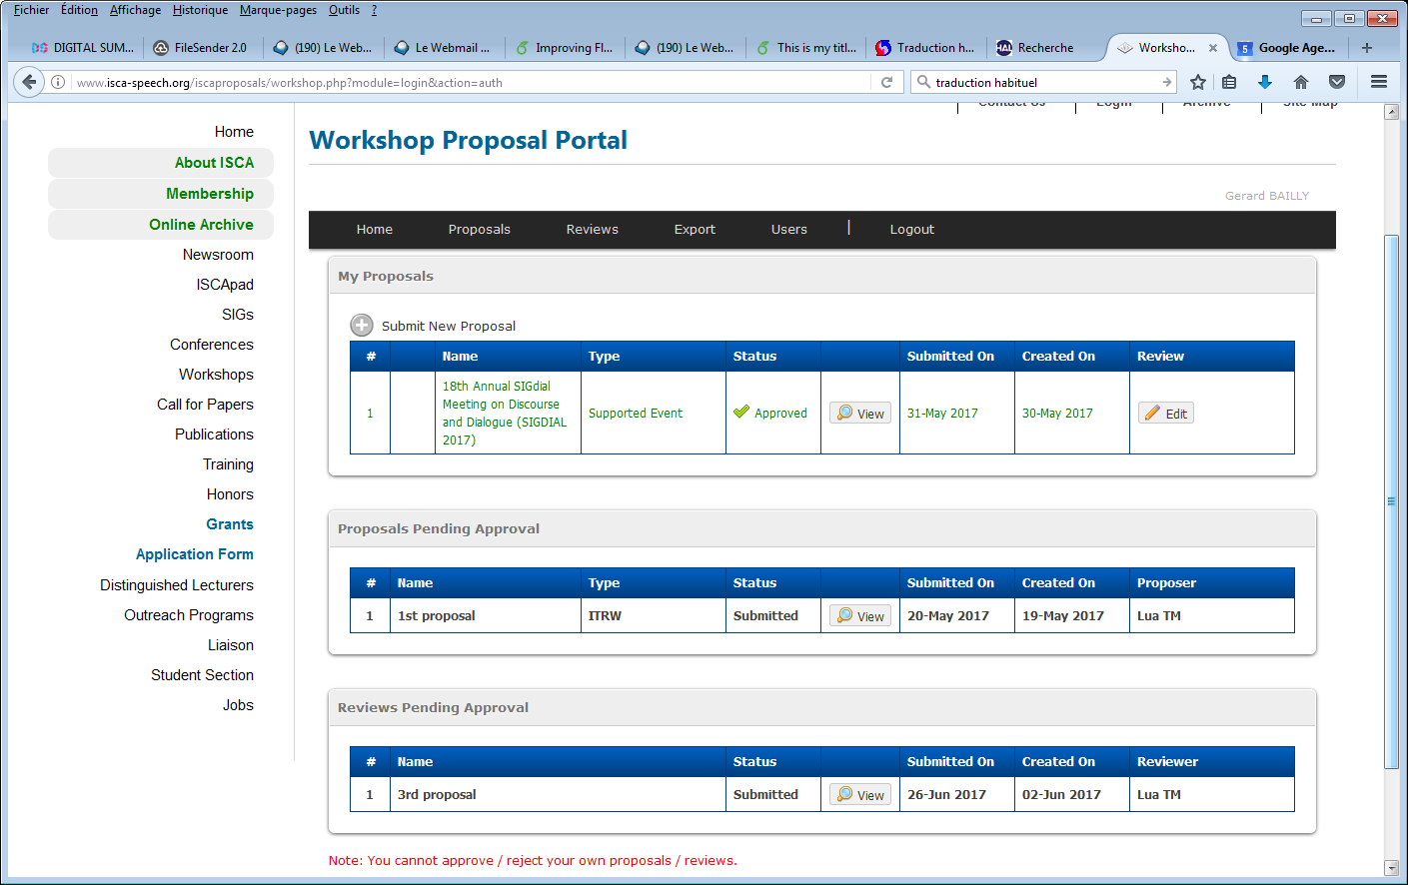
SIG & workshops news
Workshop application portal
  All workshops fill an application!! Even those endorsed by SIGs
  Post-event reports
  Sponsorship limited to 800€ per event (travel grant for one invited speaker)
  Link with students grant portal: perquisite for student travel grants

Slide 6
Workshops 2019
  20 ISCA-endorsed events in 2019
  Stable number: AVSP, AISV, IWSDS, JPC, CSC, TSD, DiGo, DISS, HSCR, SMMW, SIGDIAL, PLCL, SSW, SLaTE, LT4All
  Gathering 1945 attendees
  11 IS satellites, 2 challenges (AVSpoof, VoxCeleb)
  3 training schools (WiSSAP on Brain & Machine Perception of Speech and SuSSAP on Speaker Recognition and Diarization in India, SPC in Crete)
  ITRW & sponsored workshops: 7 travel grants for invited speakers
  5400€ for invited speakers
  12000€ for training schools

Slide 7
Topic-SIGs

Slide 8

SynSIG outcomes - 1
SSW10, Vienna, 20-22 September, 2019
  http://ssw10.oeaw.ac.at/index.html
  Chairman: Dr. Michale Pucher (Academy of Science)
  Location : Austrian museum of folk life
  55 submissions, 49 accepted papers
  54 reviewers, At least 2 reviews per paper
  Number of submissions increased compared to SSW9 (1.5 times)
  Sponsor: Amazon
  Keynotes: Aaron van den Oord (Google DeepMind, ML), Claire Gardent (LORIA, NLP), Tecumseh Fitch (University of Vienna, Austria), Bart de Boer (Vrije Universiteit Brussel, Belgium)
  Registration: ongoing (expecting 120-130 participants)

Slide 9
SynSIG outcomes - 2
SIG challenges
Blizzard Challenge 2019 workshop
  To be held on 23rd September, Same location as SSW
  Mandarin Chinese Found Data - About 8 hours of speech data from an internet talk show by a well-known Chinese character will be released
  Organizers: Zhizheng Wu, Zhihang Xie, Simon King
ASVspoof Challenge 2019 (Contribution to SpLC challenge)
  Special session at Interspeech 2019
  Logical and physical access tasks
    Logical: Speech synthesis and voice conversion
    Physical: Replay speech
  Collected 19 different types of synthesized or converted speech thanks to many kind organizations
  A new open database

Slide 10
SynSIG plans
Future plans
Summer school on speech synthesis
  Interact with “the summer school on speech synthesis systems” organized by Prof. Yannis Stylianou
  Collected from video recordings of past lectures
  Plan to upload them to video archive or SNS (Youtube)
Misc
  Change the current web server to a new one
  Look for potential organizer(s) for SSW11

Slide 11
Robust Speech Processing SIG
https://isca-sig-rosp.github.io/ISCA-SIG-RoSP/
Number of members stable to ~150
New RoSP organization
  Chairperson: Shinji Watanabe at Johns Hopkins University
  Secretary: Marc Delcroix at NTT
Building a new collaborative scheme with our SIG members
  Created the GitHub organization for this SIG activities
    https://github.com/isca-sig-rosp/ISCA-SIG-RoSP
  Moving existing contents
  Manage the database information and evaluation results (leaderboard) through the GitHub repository
    Members can easily contribute it and interact with us and other members through GitHub. Also their contribution is visible.
    We are working on launching the leaderboard for major RoSP task

Slide 12
Robust Speech Processing SIG
https://isca-sig-rosp.github.io/ISCA-SIG-RoSP/
Currently preparing new challenges for 2019–2020:
  CHiME-6 challenge based on the CHiME-5 data, may involve diarization in addition to ASR
    Collocate at ICASSP 2020 at Barcelona (before/after ICASSP)
    Challenge launch: early November
    Challenge/workshop deadline: Apr 3
    Tightly collaborating with DIHARD and Jelinek workshop researchers to make use of their diarization outcomes for our new baseline
  Several ongoing challenge planning, e.g.
    Chinese far-field speech recognition challenge
    Robust paralinguistics (human-robot interaction scenario – under discussion as part of ComParE)

Slide 13

SIGDIAL 2019
SIGDIAL 2019 at KTH, Stockholm, Sweden
  September 11-13
  Semi-co-located with Interspeech, Vienna
  ~50 accepted papers (~150 submitted)
  Special session on Deep Learning for SDS, Panel discussion
Young researchers roundtable on SDS (YRRSDS)
  September 9-10 at KTH
  Yearly meeting for PhDs, Post-docs and young researchers in SDS
New Exec elected
  Gabriel Skantze (president), Mikio Nakano (VP), Ethan Selfridge (Treasurer), Vikram Ramanarayanan (Secretary)
Endorsing
  Dialogue & Discourse, SemDial, IWSDS, Workshop on NLG

Slide 14
SIGDIAL 2020
SIGDIAL 2020 at Boise State University, USA
  July 14-16
  Semi-co-located with ACL, Seattle
  Local chair: Casey Kennington
  General chair: Olivier Pietquin
  Program chairs: Smaranda Muresan & Vivian Chen

Slide 15
SIGUL
Joint Special Interest Group
  International Speech Communication Association (ISCA)
  European Language Resources Association (ELRA)
  (SaLTMil members have approved the creation of SIGUL)
Main objectives
  Supports linguistic diversity through technology and ICT
  Commits to increase the lesser-resourced languages (regional, minority, or endangered) chances to survive the digital world
Board (2017-2019)
  Chair and ELRA liaison representative: Claudia Soria (CNR-ILC, Pisa, Italy)
  Co-chair and ISCA liaison representative: Laurent Besacier (LIG, France)
  Secretary: Sakriani Sakti (NAIST, Nara, Japan)
  Contributor: Dorothee Beerman (NTNU, Norway)

Slide 16
SIGUL activities
ICPhS 2019
  Special session at ICPhS 2019 (Melbourne, Australia, Aug 2019) – Computational Approaches for Documenting and Analyzing Oral Languages
  Attracting computer scientists to ICPhS and engaging them in discussions with phoneticians (and linguists generally)
UNESCO 2019 International Year of Indigenous Languages
  Local Workshop with lectures and data collection in Uganda (Nov 2019, in connection with ISCA distinguished lectures series)
  Digital Revolution for Under-resourced Languages in Asia (Nara, Japan, Feb 2019)
  LT4All - Worldwide conference on Language Technologies that will take place at UNESCO Headquarters in Paris (France) on December 5-6, 2019
Zero Speech Challenge 2019
  TTS without T - Special session at Interspeech 2019 (Graz, Austria, Sep 2019)
LTC 2019
  Track on less resourced languages at LTC (Poznan, Poland, May 2019)
Setting up a newsletter

Slide 17
SIGUL plans
Joint SLTU & CCURL in May 2020
  In Marseille (France), before LREC 2020
  3 days workshop - 100 participants targeted - fusion of 2 WS
SIGUL Board elections in January 2020
  Last (and first) elections were in December 2017
ISCA Distinguished Lecture Series Tour
  Seminars in Tunisia in 2020

Slide 18
SIGML: MLSLP 2018
September 7, 2018, Hyderabad.
https://sites.google.com/view/mlslp/home
General Chairs: Preethi Jyothi, Rohit Prabhavalkar
Program Chairs: Liang Lu, Tara Sainath
Local Organizer: Negar Saei
Attendance:
  The registration website was opened before paper acceptance/reject decisions were announced. 100 people registered before the site was closed (about 24 hours).
  In the end, after guaranteeing registration to everybody with an accepted paper, we had 130 registrations.
  About half of the registrations were revoked (with apology, in advance) because the room was too small. In the end, 75 people were admitted.
Presentations:
  5 oral presentations by invited speakers
  13 poster presentations of regular papers, which were also published in the Proceedings

Slide 19
SIGML Plans 2020
Traditionally, MLSLP alternates between
  ICML co-location: 2011, 2017
  Interspeech co-location: 2012, 2016, 2018
  There was no MLSLP in 2019. Possibly the next one will be held in 2020.
Officer Elections
  Officer nominations are currently open, at https://forms.gle/DesG4fQWfKHxACSB8
Open Question: has SIGML served its purpose?
  2010: Speech community still considered HMMs to be state of the art in machine learning. ML researchers rarely published in speech venues. SIGML founded to remedy these ills.
  2019, evidence that SIGML is done: speech, NLP, and computer vision compete to give ML the most interesting problems. ML researchers attend Interspeech.
  2019, evidence that SIGML should continue: the popularity of MLSLP. Students like the chance to meet our invited speakers, and to present posters on ideas that are really interesting but not yet conference-worthy. Some of those posters have later evolved into Interspeech papers.

Slide 20
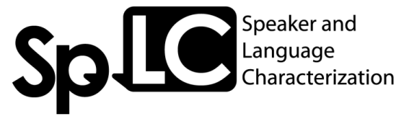
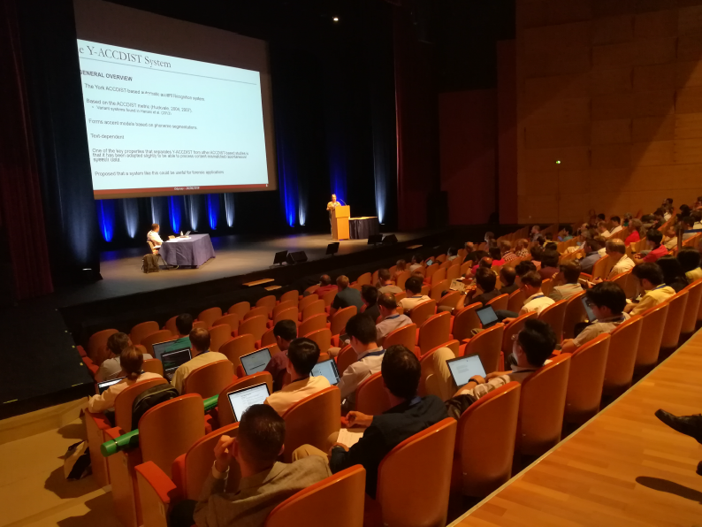
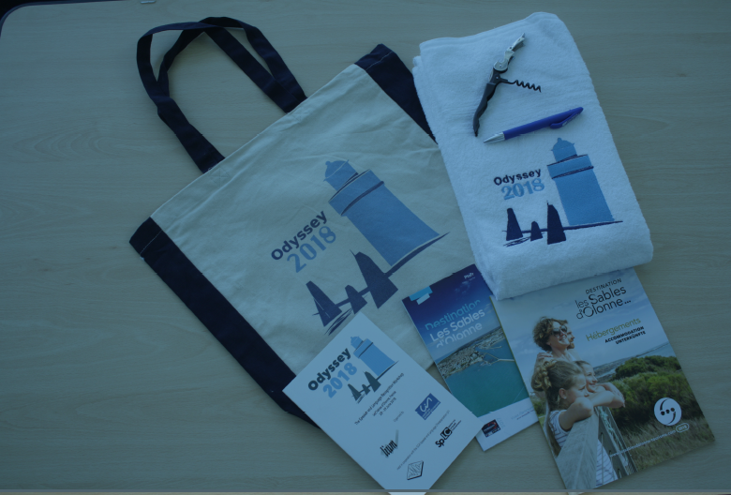
SpLC Outcomes
Odyssey 2018, 11th ISCA ITRW, Les sables d’Olonne, France
  Success reported at the Interspeech 2018 SIG lunch meeting
  Chairs: JF Bonastre & A Larcher
  7 oral, 2 poster, 1 special session (voice conversion challenge), 1 round academic-industry round table (real world challenges); single track, 4 days, 127 participants, 3 keynotes (Els Kindt, Simon King, Pascal Belin), 3 social events
CSL Special issue on Speaker and language characterization and recognition: voice modeling, conversion, synthesis and ethical aspects
  Guest editors: JF Bonastre (Univ. Avignon, France), A Larcher (Le Mans Univ, France), T. Kinnunen (UEF, Finland), J. Yamagishi (NII, Japan), published June 2019 (8 published articles)
ASVspoof 2019 challenge (https://www.asvspoof.org/)
  Joint activity of SpLC and SynSIG (text-to-speech & voice conv attacks)
  Logical and physical attack tasks, 63 participating teams
  Data public: https://datashare.is.ed.ac.uk/handle/10283/3336
  Interspeech 2019 special session; follow-up special session in IEEE ASRU
CSL Special issue on Two decades into Speaker Recognition Evaluation - are we there yet?
  Guest editors: KA Lee (NEC, Japan), O Sadjadi (NIST, USA), H Li (NUS, Singapore), D Reynolds (MIT LL, USA)
  To appear ~December 2019

Slide 21





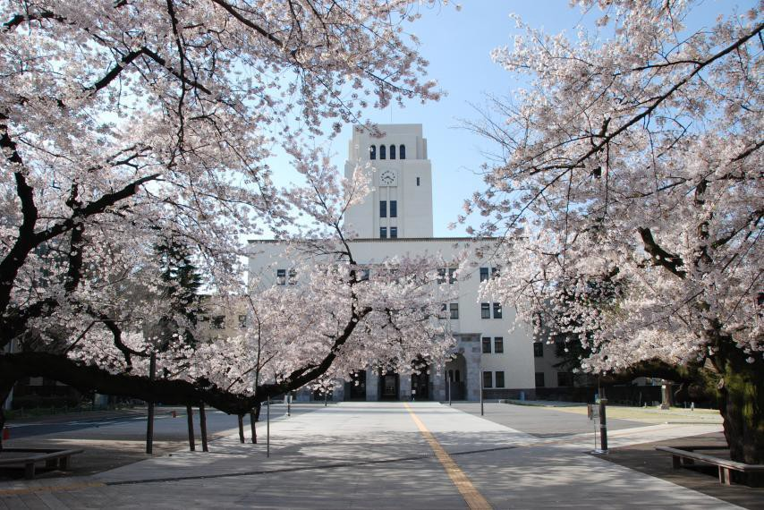
SpLC Plans
Speaker Odyssey 2020
  Tokyo, Japan, 18-21 May 2020
  Tutorial day: 17 May 2020
  Chairs: KA LEE, NEC Corp, Japan; T KOSHINAKA, NEC Corp, Japan; K SHINODA, Tokyo Tech, Japan
CSL special issue on Advances in Automatic Speaker Verification Anti-spoofing
  Guest editors: A Nautch (Eurecom, France), H Delgado (Nuance, Spain), M Todisco (Eurecom, France), M Sahidullah (Inria, France), V Vestman (UEF, Finland), X Wang (NII, Japan)
  Advisory committee: J Yamagishi (NII, Japan), KA Lee (NEC, Japan), N Evans (Eurecom, France), T Kinnunen (UEF, Finland)
  To appear ~March 2020

Slide 22

Speech Prosody SIG (SProSIG)
2018:
new officers: Ward, Chen, Ding, Grice, Barbosa
updated website: sprosig.org
new logo:
ISCA SIGs meeting, September 17 2019

Slide 23
Speech Prosody SIG (SProSIG)
2019:
gradual divergence
2020:
Speech Prosody, May 24-28, Tokyo
Tone and Intonation, August 16-20, Sønderborg, DK
the merger of Tonal Aspects of Languages (TAL)
and Tone and Intonation in Europe (TIE)
ISCA SIGs meeting, September 17 2019

Slide 24

AVISA Activities 2019
The AVISA listserv has 169 members
AVISA has a continuing social media presence - AVSP twitter account – @AV_SP which now over 990 followers
Organized AVSP 2019 in Melbourne (as an ICPhS 2019 satellite conference) – continued the low-cost format – about 24 people attended
Introduced a Short history of AVSP which we will include on the AVISA web site and use to build member profiles

Slide 25
AVISA Plans
AVSP 2021 – looking into having a conference in the Czech Republic, as satellite to Interspeech 2021 (Brno)
Continuing to expand the AVISA web site – e.g., history of AVSP and member profiles

Slide 26
New topic-SIG

Slide 27
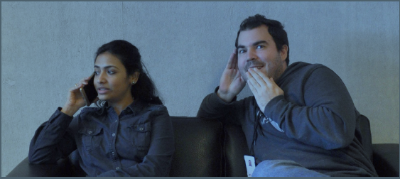
SPSC: Security & Privacy in Speech Communication
Coordinators of the submission:
  Tom Bäckström, Aalto University
  Andreas Nautsch, EURECOM

Slide 28
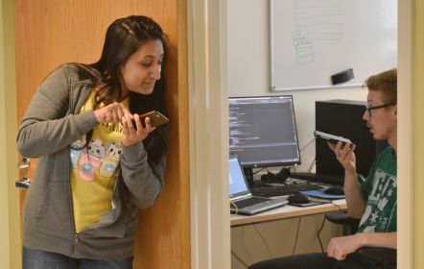
SPSC: Security & Privacy in Speech Communication
Motivation
Urgent need and broad interest
  Increasing news coverage of GDPR
  vs. speech data processing
  Industrial/academic projects rejected
  due to privacy concerns
  We have to do something!
Bridging fragmented discussions
  Across all fields of speech communication, but also outside ISCA
  Reach out & learn from each other
  Connect legal framework & requirements with scientific expertise
Protect against security/privacy abuse of ISCA technology
  Our value: User-centric design = usable security & usable privacy
  Ethical, moral, social and cognitive discussion = what is privacy and what should it be?

Slide 29
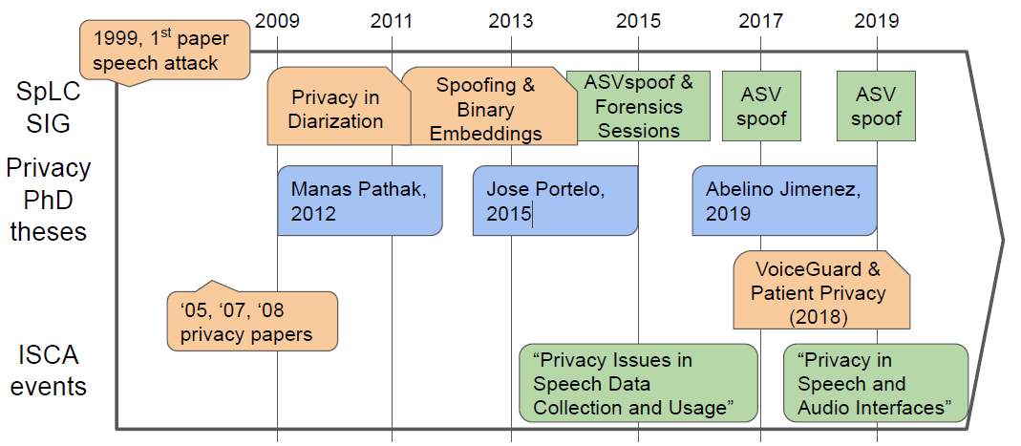
SPSC: Security & Privacy in Speech Communication
10 Years of ISCA security & privacy research

Slide 30
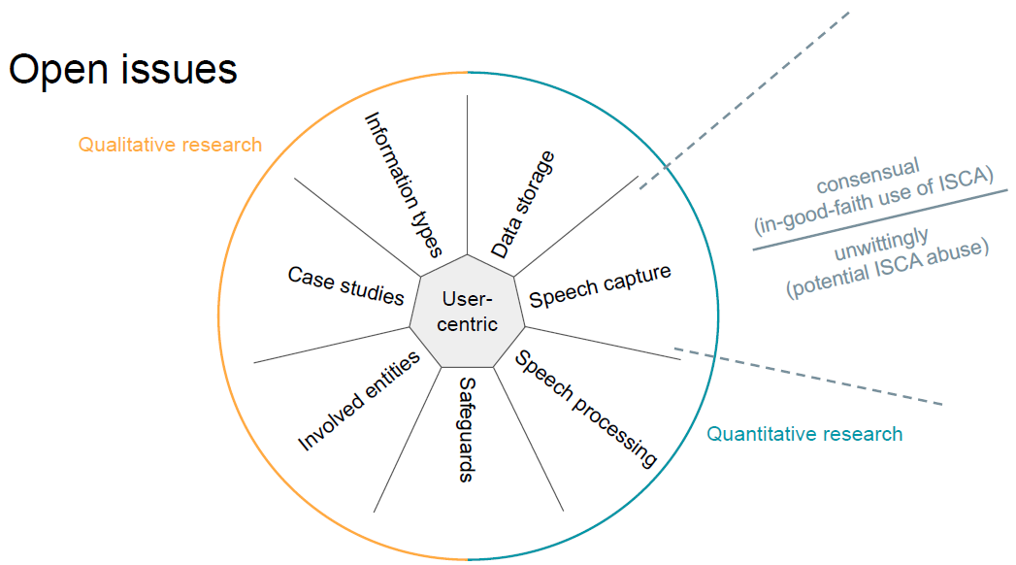
SPSC: Security & Privacy in Speech Communication

Slide 31
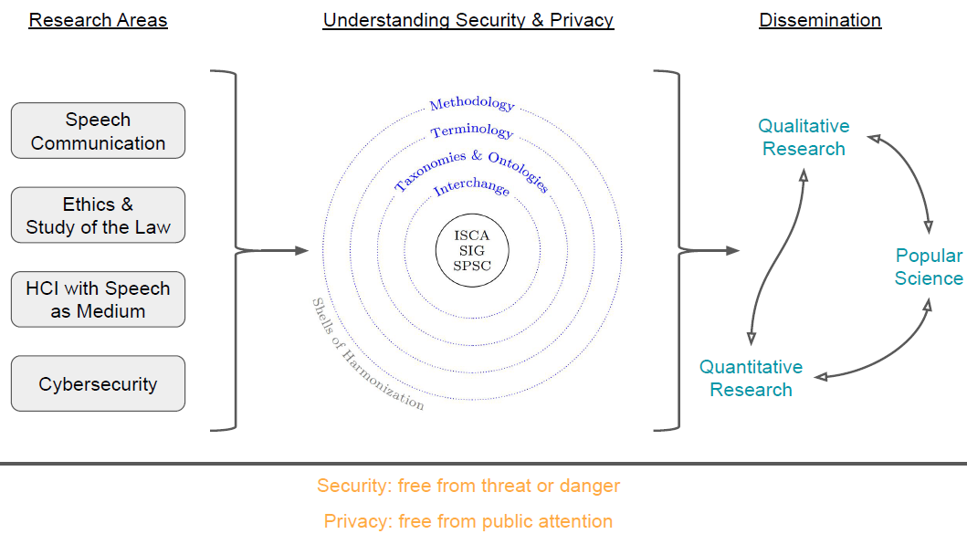
SPSC: Security & Privacy in Speech Communication

Slide 32
SPSC: Security & Privacy in Speech Communication
ISCA SIG proposal
Main goals
  Interdisciplinary discussion platform and ecosystem
  Curated website on SPSC
  Initiatives to engage & exchange (students, software, guidelines)
  Starting point for Joint-SIG with ISCA at its core (e.g., IEEE, EURASIP, OSAC, ...)
  Encourage organization of special sessions, workshops, special issues, challenges, etc.
SPSC in liaison with all ISCA SIGs
  Strong overlap with ISCA SIG SpLC (e.g., ASVspoof challenges)
  SPSC effects all fields in ISCA but SPSC needs to focus in one place
Industrial and institutional interest for SPSC
  XMOS, Omilia, Pindrop, and more
SPSC connects established networks

Slide 33
SPSC: Security & Privacy in Speech Communication
Roadmap 2020
Confirmed events
  “Privacy and Security in Digital Assistants”, Workshop, PerCom 2020, Austin, Texas
  “Privacy, Ethics, and Legislation for Speech Communication”, NII Shonan Meeting, Shonan Village Center, Japan
Upcoming challenges in liaison; in-preparation
  Voice privacy
  Detection and classification of acoustic scenes and events
In preparation
  Special issue for EURASIP Journal on Audio, Speech and Music Processing (JASMP)
  COST Action
  JHU JSALT Workshop

Slide 34
Language-SIGs

Slide 35
AFCP
Association Francophone de la Communication Parlée:
French non-profit association since 2001
Aim: association for the support, development, dissemination and promotion of speech sciences and technology in the French-speaking community
Board elected every 4 years
(16 members, on-going: 2017—2020)
  Chairman: Véronique Delvaux
  Vice-Chairman: Martine Adda-Decker
  Treasurer : Camille Fauth (vice-tr: Yohann Meynadier)
  Secretary : Emmanuel Ferragne, (vice-secr: Thomas Pellegrini)
End of 2018: 160 members including 35 % of students and 12% out of France

Slide 36
AFCP outcomes & plans
Financial and scientific sponsorship
  Award for the best dissertation
    Latest: Marie-Lou Barnaud (Gipsa-Lab, Grenoble): “Modélisation bayésienne du développement conjoint de la perception, l’action et la phonologie”, 2018
  Support for the organization of scientific events
    LREC 2020, Marseille, 2020
    Language Technologies for All (LT4All), Paris, 2019
    JPC 2019: Journées de Phonétique Clinique, Mons, 2019
    Conference « Pratiques contemporaines de l’histoire orale. De l’entretien aux archives orales », Paris 2019
    REAL 2, Nantes 2018
    Summerschool « Big data and speech », Roscoff, 2018
    Speaker Odyssey, Les Sables d’Olonne, 2018
    Ateliers Science et Voix, Grenoble, 2017-2018
  Travel grants for students & postdocs
    Approximately 10 grants each year

Slide 37
AFCP outcomes & plans
Main conference: Journées d’Etude sur la Parole JEP
  Every 2 years,
  1 time in 2 (every 4 years): joint organization: JEP-TALN (main conference of ATALA, the French Association for Natural Language Processing)
  Next: 33th JEP-TALN 2020 « TAL pour l’humain »: LORIA, ATILF & INIST; Nancy; expected: around 250 papers and 350 participants
Community animation
  AFCP Training days; latest: ‘Statistiques et données phonétiques atypiques’, 2017, Paris
  Mailing List: « parole », web site, social networks
  Science/Society issues (Forensic phonetics, Artificial intelligence, Standards of scientific communication, etc.)
  Joint initiatives (European General Data Protection Regulation, safeguarding of instrumental phonetics heritage, etc.)

Slide 38
SIG-CSLP
Chinese Spoken Language Processing – since 2002
About 330 registered members
  URL: www.isca-cslp.org
  Officers
    Since November 2018
      Chairperson: Jianhua Tao, Chinese Academy of Sciences, Beijing
      Vice Chairperson: Tan Lee, The Chinese University of Hong Kong
      Secretary: Minghui Dong, I2R, Singapore
    2015 - 2018
      Chairperson: Helen Meng, The Chinese University of Hong Kong
      Vice Chairperson: Bin Ma, I2R, A*Star, Singapore
      Secretary: Yao Qian, ETS
  Flagship event: ISCSLP (since 1998)

Slide 39

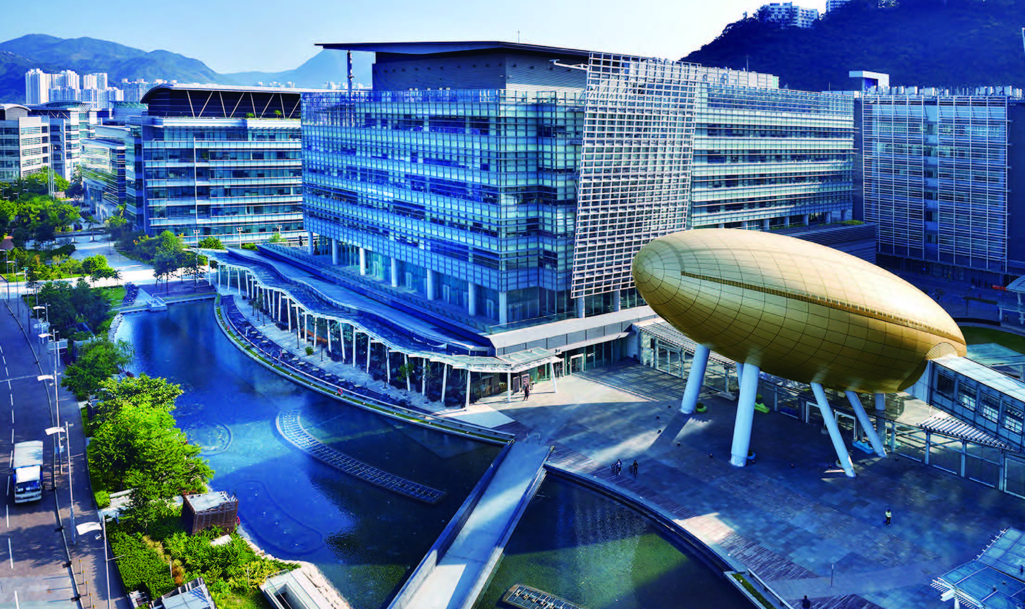
The 11th International Symposium on Chinese
Spoken Language Processing (ISCSLP2018)
November 26-29, 2018, Taipei, Taiwan
http://iscslp2018.org
The 12th International Symposium on Chinese
Spoken Language Processing (ISCSLP2020)
December 9-12, 2020, Hong Kong
Honorary Chair:
P.C. Ching, The Chinese University of Hong Kong
William S.-Y. Wang, The Hong Kong Polytechnic University
Steering Committee Chair:
Helen Meng, The Chinese University of Hong Kong
General Co-Chairs:
Tan Lee, The Chinese University of Hong Kong
Brian Mak, The Hong Kong University of Science and Technology
Technical Program Co-Chairs:
Man-Wai Mak, The Hong Kong Polytechnic University
Xunying Liu, The Chinese University of Hong Kong
Venue:
Charles K. Kao Auditorium
Hong Kong Science and Technology Park

Slide 40

AISV
Associazione Italiana di Scienze della Voce
Italian Association of Speech Sciences
Aim: promoting Speech Sciencies in Italy, from the scientific, thecnological, industrial, social, professional and didactical point of view
Board elected every 3 years
(5 members, on-going: 2019—2021)
  Barbara Gili Fivela (Chairman), Alessandro Vietti (Vice-Chairman), Chiara Celata, Silvia Calamai, Stephan Schmid
About 100 members
  5 Honorary members: Emanuela Magno Caldognetto, Arianna Uguzzoni, Pier Luigi Salza, Piermarco Bertinetto and Piero Cosi

Slide 41
Outcomes & plans
Main conference: Convegno annuale dell’AISV
  Each year, around 100 participants
  Next: Cosenza, 29-31 January 2020 « Linguistic variation in contact situations»
Pubblications
  Studi AISV: selection of papers presented during the annual meeting
  Studi AISV – monographs: books on speech related issues

Slide 42
Outcomes & plans
Communication and collaborations
  Web site, Newsletter (3 times a year)
  Other Scientific associations: AISO (Oral studies)
  AISV Delegate for ISCA (Piero Cosi), for CLARIN (Silvia Calamai)
Financial and scientific sponsorship
  Award for the best student paper during the annual meeting
  Support and sponsorship for the organization of scientific events
    Phonetics and Phonology in Europe - PaPE 2019, Lecce (17-19 June)
    Conference on Transcription – AISO (June 2020, Milan)
  Grants for students & postdocs
    Call for 4-5 grants each year

Slide 43
SIGRU – outcomes
Organization of the Conference on Conversational Russian Speech Analysis and publication of its Proceedings in Russian with English abstracts, January 2019. Official biannual seminar of SIGRU.
Promotion of the session on Phonetics at the XLVIII International Philological Conference in March, 2019 in Saint-Petersburg.
Support of Conference in Speech and Computer (SPECOM 2019), http://specom.nw.ru.
Co-organization of biannual Conference on Corpus Linguistics, gathering specialists in the field from all the Russia, June 2019 (https://events.spbu.ru/events/corpora-2019?lang=Eng).
Publication of the “Phonetic Lyceum”, vol. 5 – a collection of student articles on phonetics and speech technologies, written in Russian with English abstracts, indexed in Russian Citation Index (https://elibrary.ru/item.asp?id=38544202).

Slide 44
SIGRU – plans
Promotion of the session on Phonetics at the XLIX International Philological Conference in Saint-Petersburg.
Co-organization of Conference in Speech and Computer (SPECOM 2020).
Publication of the “Phonetic Lyceum”, vol. 6 – a collection of student articles on phonetics and speech technologies, written in Russian with English abstracts, indexed in Russian Citation Index.

Slide 45
Discussions
Workshops
  IS satellites: too many? Difficult to choose between overlapping dates? Competing with IS sessions?
  Partnership with other associations/workshop series (e.g. WOCCI + ICMI, AVSP + ICPhS): pros (SIG at frontiers) vs. cons (drop-outs of regular attendees, copyrights)
  Avoid workshops with no ISCA endorsement
SIG treasures, workshop cash-flows
New SIGs
  NoLISP, speech production, phonetics, brain studies?

