Slide 1
ISCA GENERAL ASSEMBLY
INTERSPEECH 2012
PORTLAND, USA

Slide 2
Agenda
  Opening remarks and approval of the Minutes of the 2011 General Assembly (Florence)
  Treasurer’s report
  President’s report
  Approval of the reports
  Future of ISCA and ISCA goals for 2012-2013
  Comments, Suggestions and Questions from ISCA Members
  Announcement of next ISCA General Assembly

Slide 3
Minutes of the General Assembly, 2011, Florenze, 29 August, 6 PM
  1. Opening remarks and approval of the Minutes of the 2010 General Assembly (Makuhari)
  2. President’s report
  3. Treasurer’s report
  4. Approval of the reports
  5. Announcement of changes to the ISCA Board
  6. ISCA goals for 2011-2012
  7. Comments, Suggestions and Questions from ISCA Members
  8. Announcement of next ISCA General Assembly
  9. Any other business
  10. Handover to the New President

Slide 4
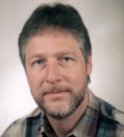

Treasurer’s Report
Bernd MÖBIUS

Slide 5
Treasurer’s Report
Highlights
Bernd MÖBIUS
ISCA's assets still growing
  result of the year (income over expenditure) for 2011 negative due to unusually large sum of receivables
  all receivables collected in 2012
Solid financial basis for
  continued Interspeech, ITRW and SIG seed funding
  increased student grant support
  new initiatives (cf. President's report)
Consistent savings thanks to
  Student Committee initiatives
  volunteers: Archive (W. Hess), ISCApad (C. Wellekens)

Slide 6
Treasurer’s Report
Income | 2010 | 2011
Membership fees | 54,364 | *22,351
Interspeech donation | 47,629 | **50,678
ITRW shares | 7,110 | 0
Proceedings | 0 | 323
Interest on Savings | 3,047 | 3,256
TOTAL (€) | 112,150 | 76,608
* membership fees from IS-2011 (€ 39,900) received in 2012
** extra donation from IS-2010; donation from IS-2011 (€ 48,520)
received in 2012

Slide 7
Treasurer’s Report
Expenditure (1) | 2010 | 2011
Salaries | 37,471 | *44,284
Board/Committee meetings | **4,951 | **4,307
Secretariat | 4,688 | 4,181
Grants & Awards | 15,820 | 17,786
Special Interest Groups | 0 | 0
Website Administration | 5,350 | 6,329
subtotal | 68,280 | 76,887
* includes 4 years back pay of occupational accident insurance
** includes room rent for committee meetings

Slide 8
Treasurer’s Report
Expenditure (2) | 2010 | 2011
(carried over) | 68,280 | 76,889
Distinguished Lecturers | 5,242 | 3,960
Workshop support | 2,050 | 1,200
Training & Education | 0 | 0
Archive | 0 | 0
Contingency | 0 | 598
Bank Costs | 1,317 | 1,408
TOTAL (€) | 76,889 | 84,053

Slide 9
Treasurer’s Report
Assets | 31/12/2010 | 31/12/2011
BANK BALANCE | 193,696 | 136,260
RECEIVABLES | *50,000 | **184,205
TOTAL ASSETS (€) | 243,696 | 320,465
Liabilities & Equity
PAYABLES | 0 | 0
EQUITY (€) | 243,696 | 320,465
* seed money for IS-2011
** IS-2011 seed money, donation, membership fees; IS-2012 seed money
Each year ISCA gives seed money to 1-2 Interspeech conferences and 1-2 workshops. Assets >€112k are required to maintain a positive cash balance.

Slide 10
Treasurer’s Report
Conclusion (1)
ISCA is financially sound
ISCA has repeatedly benefited from generosity of IS organizers donating their profit
ISCA is investing in new initiatives: Video Archive, Training Schools, Lectures Program
  ISCA increased the number of student travel grants to 40 (from 20), starting 2012
ISCA will continue to provide seed money for Interspeech conferences and ITRW workshops

Slide 11
Treasurer’s Report
Conclusion (2)
ISCA is working with Interspeech organizers to reduce or share financial risks
  aiming at reduced registration fees by encouraging a raise of the break-even target
  financial risk for ISCA: coverage of potential deficit arising from missing the raised target (max € 50k)
  first achievements by IS-2012
    significant lowering of registration fees by Portland team
    50% reduction of ISCA's share for student participants

Slide 12
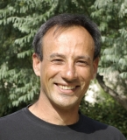
President’s Report
J.F. Bonastre

Slide 13
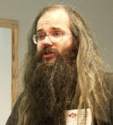
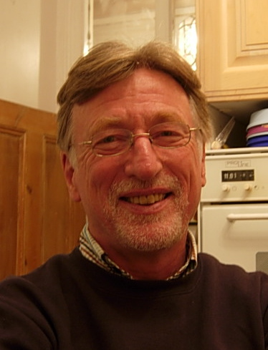
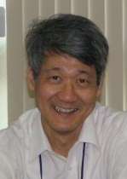
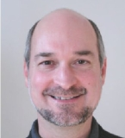
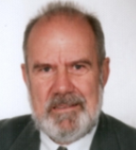
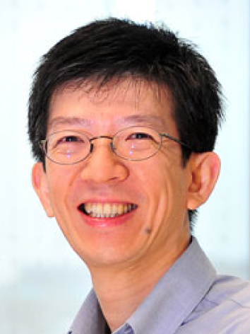
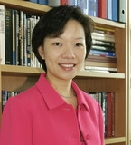
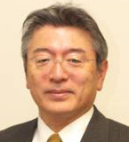
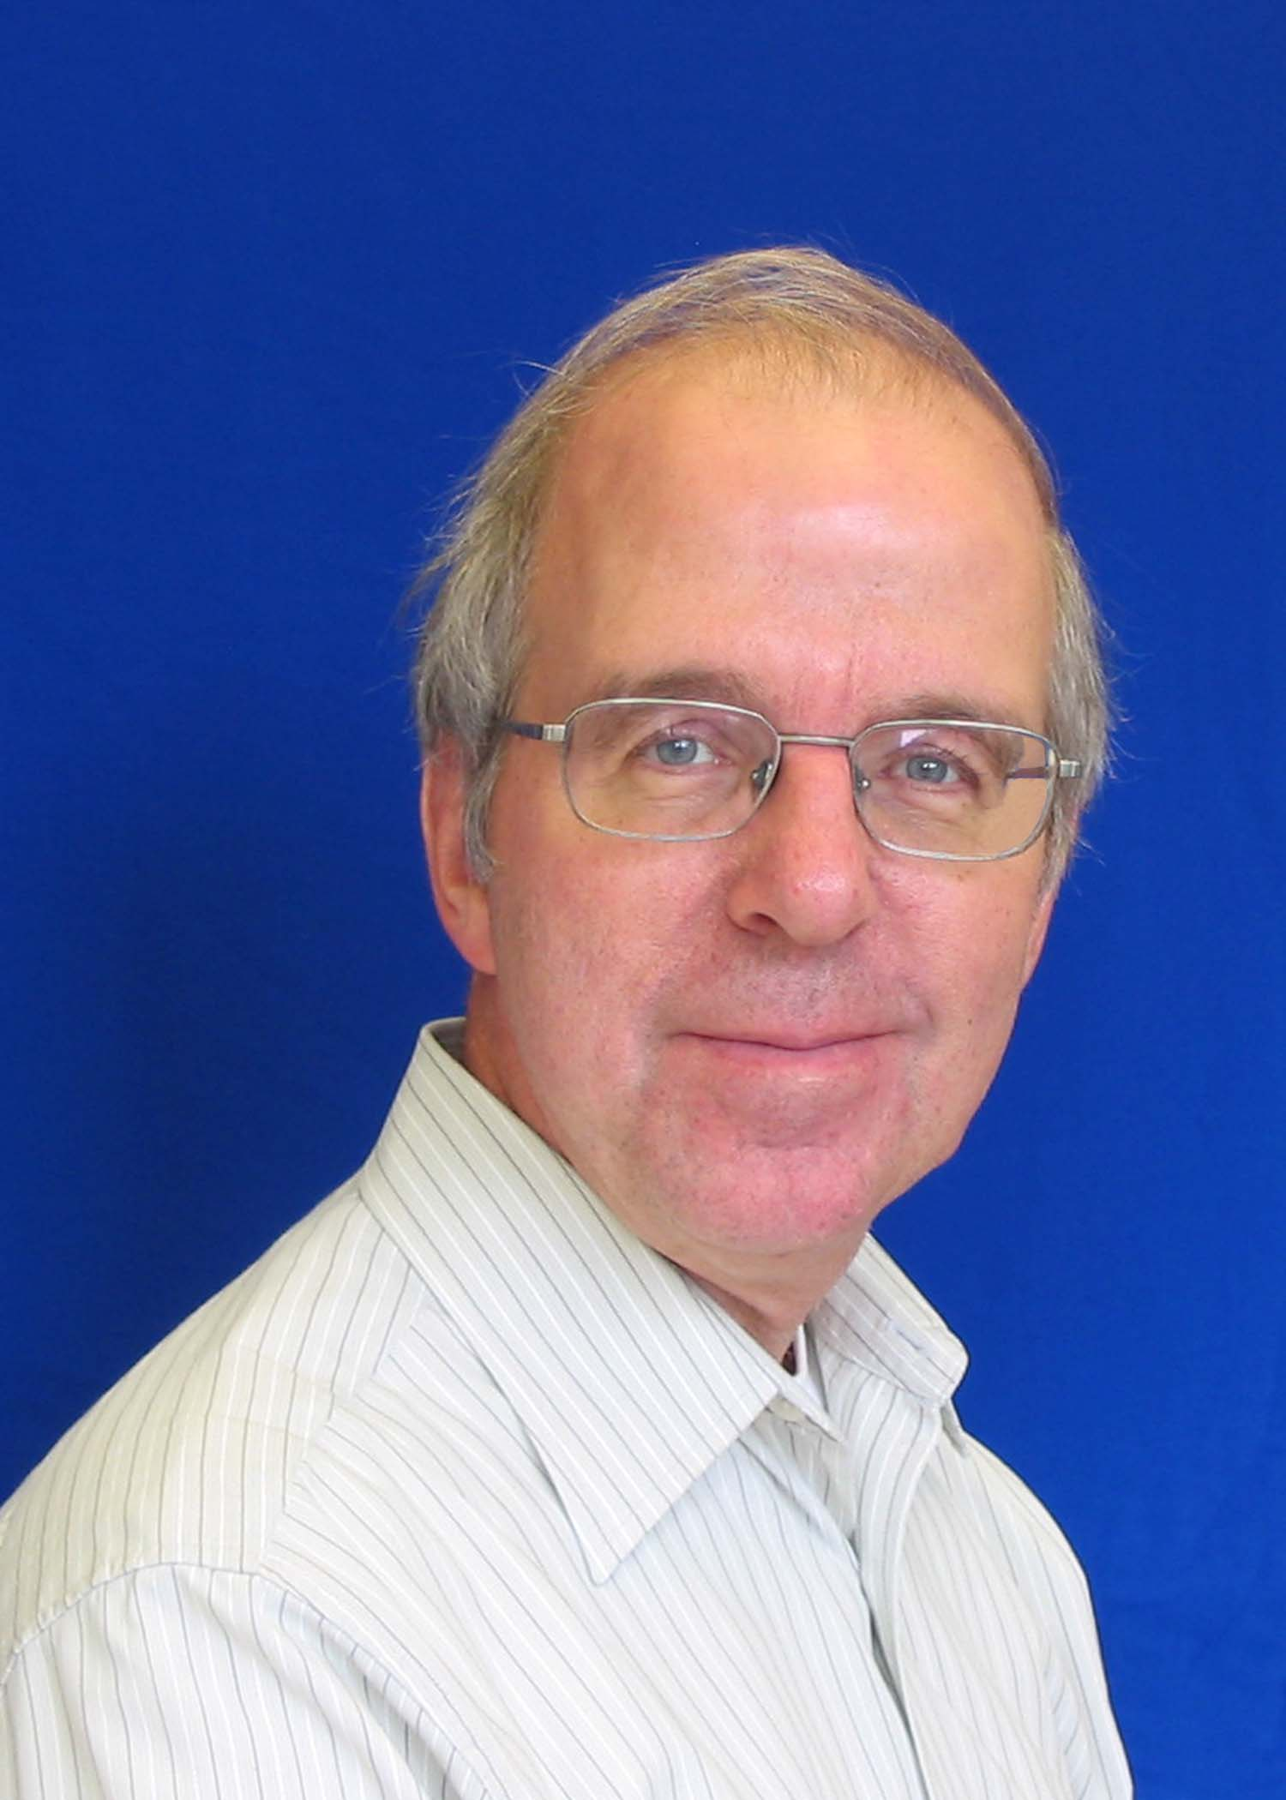
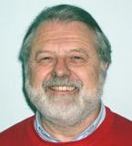
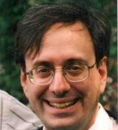
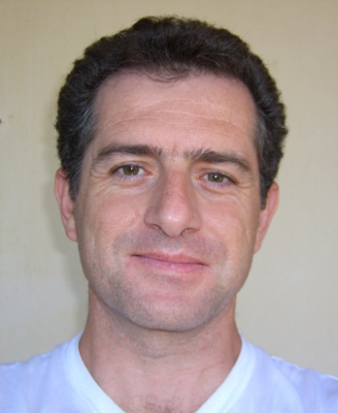
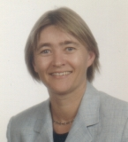
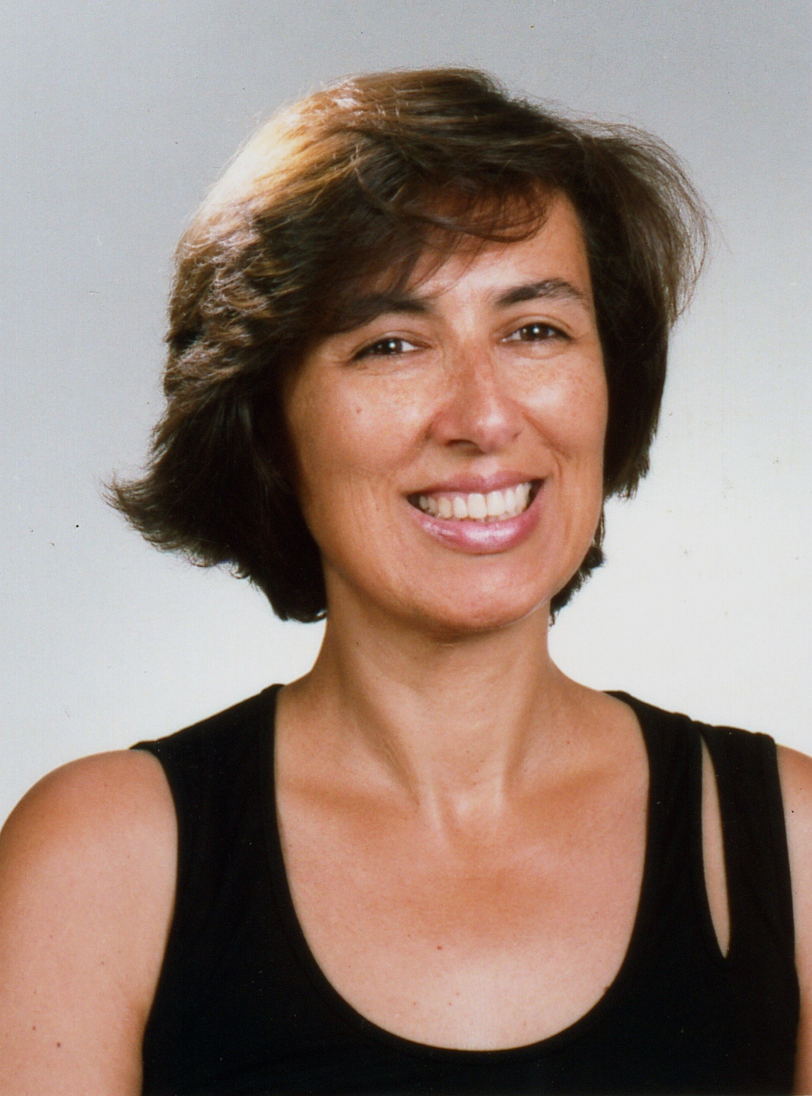
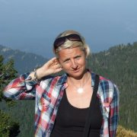
President’s Report (J.-F. Bonastre)
Alan Black
Grants & Awards
J.François Bonastre
President
Nick Campbell
Workshops
Keikichi Hirose
Fellows
David House
Publication
Wolfgang Hess
Archive
Ex-officio members
Haizhou Li
Web & Archive
Helen Meng
SAC Liaison
Bernd Möbius
Treasurer
Satoshi Nakamura
DL, SIGs (language)
D. O‘Shaugnessy
Vice-P. & Secretary
Chris Wellekens
ISCApad
Adm. Secretary
Michael Picheny
SIGs, Ind., Journals
Yannis Stylianou
Educ., Video Archive
Tanja Schultz
Future Conferences
Isabel Trancoso
Current Conference
Emmanuelle Foxonet

Slide 14
Membership Development from 2001-2012
Total August 2012: 1724

Slide 15
Membership by country 2012
Countries >= 10 members (1618 members, 25 countries)

Slide 16
Membership by country 2012
Countries < 10 members (106 members, 35 countries)

Slide 17
ISCA News in 2011-2012 (1)
ISCA Web
  December 2011, ISCA new membership portal
  August 2012, ISCA upgraded board portal
  ISCA Jobs/workshops posting service was migrated to ISCA Web in Jan 2011
  ISCA voting portal (included in ISCA Web) for future elections and surveys
75 workshops/conferences sponsored or supported !
New SIGs:
  SIG-HST – History of Speech Communication Science
  SLIM – Speech and Language in Multimedia
  SIG-ROB – Robust Signal Processing (in formation)
Notes:
17

Slide 18
ISCA News 2011-2012 (2)
Distinguished Lecturers Program
  Several trips in the past year (3)
  New DLs (Selection Committee Chair: Julia Hirschberg)
    Sadaoki Furui
    Hermann Ney
Liaison with ISCA Journals
  Yearly best paper awards for SPECOM and CSL
  Six of top IS2010 papers expanded for publication in journals
ISCA Fellows (Selection Committee Chair: Lin-shan Lee)
  4 new fellow awarded in 2012:
    Chin-Hui LEE
    John OHALA
    Yoshinori SAGISAKA
    Stephanie SENEFF
Notes:
18

Slide 19
ISCA News 2011-2012 (3)
Awards
  ISCA Medal for Scientific Achievement 2012 (Recipient: Chin-Hui Lee)
  ISCA Award for the best paper published in the Speech Communication Journal 2009-2011
  ISCA Award for the best paper published in the Computer Speech and Language Journal 2007-2011
  3 ISCA Awards for the Best Student Paper of INTERSPEECH 2012
TBA Thursday at the Interspeech 2012 closing ceremony
Grants September 2011-12
  Fixed amount per grant (650 Euros)
  51 grants (6 events) 2012
  40 for Interspeech 2012
  Total = 33150
  +20 grants comming from the Interspeech 2012 Organizers
Thanks to Interspeech 2010 for the extra donation!!

Slide 20
ISCA News 2011-2012 (4)
INTERSPEECH Registration Fees
2 Steps from ISCA:
Increasing the financial risk taken by ISCA
ISCA share cut in half for student participant
These steps have only been possible thanks to the enormous efforts of past Interspeech organizers.
Very meritorious efforts from current organizers to further lower the registration fees, namely for students
The registration fees for IS2012 are the lowest in 10 years!
ISCA will go to 4+1 papers for IS2013

Slide 21
ISCA News 2011-2012 (5)
The ISCA video-archive is growing (Plenary lectures and slides from Interspeech 2007, 2010 and 2011, Talks from Odyssey 2010 and 2012)
ISCA Seminar (Lecture) Program
  distribute some important and established material on speech communication for education purposes
ISCA Training Schools
  ISCA contribution of up to 10000€
  Proposals are submitted each year twice:
    by February 15th, for Summer Schools
    by July15th, for Winter Schools
  More info at ISCA web:
  http://www.isca-speech.org/iscaweb/index.php/outreach/training

Slide 22






ISCA Student Advisory Committee
Current Members
Term Completion
Samer Al Moubayed
Transition Coordinator
KTH, Sweden
Maria Eskevich
General Coordinator
Dublin City University, Dublin, Ireland
Matt Speed
Content and Publicity Coordinator
University of York, United Kingdom
Student Volunteers
Yan Tang, Universidad del País Vasco (UPV/EHU), Vitoria-Gasteiz, Spain
Ingrid Jafari, University of Western Australia
Catharine Oertel, KTH Royal Institute of Technology, Sweden
Zeynab Raeesy , University of Oxford
Xiaojun Qian, The Chinese University of Hong Kong, China
Catherine Lai
Volunteers Coordinator
University of Pennsylvania, USA
Xingyu Na
Website Coordinator
Beijing Institute of Technology, China

Slide 23
ISCA Student Advisory Committee
SAC Work in progress:
Theses Archive
SAC is now working on building an archive of the Masters and Ph.D theses being continuously archived by students in the field of speech communication.
Video broadcasting and archive
Researching a solution for video broacasting and archiving future ISCA’s conferences and event.
Tools/Software repository
SAC volunteers have built a repository of tools and software available for research in the speech and language communication field on the SAC website, it is now available on the web-site and open for expansion.

Slide 24
Goals for 2011-12 (reminder and analysis)
To enhance ISCA’s world position
  To promote high standards in ISCA’s conferences and workshops
To expand ISCA’s international aspects
  To support student-centered activities
  To provide remote access to lectures (e.g. DL program)
  To improve the representation of underrepresented countries/regions in the membership
To enhance the ISCA community
  To raise the impact factor of ISCA members’ publications
  To expand the ISCA video archive and virtual conferencing
  To understand members’ needs better and increase community involvement
  To stimulate interdisciplinary collaboration in new areas of research
  To improve current ISCA web-based services and create new ones

Slide 25
Goals for 2011-12 (reminder and analysis)
To strengthen support to students by increasing the number of grants for Interspeech and workshops
To reduce financial risks for conference and workshop organizers
To reduce Interspeech and workshop registration fees

Slide 26
Upcoming INTERSPEECH Conferences
INTERSPEECH 2013: Lyon, France, August 25–29, 2013
INTERSPEECH 2014: Singapore, September 14-18, 2014
INTERSPEECH 2015: Dresden, Germany, September 6-10, 2015
Call for proposals for INTERSPEECH 2016
(Nov. 1st. 2012 deadline)
www.isca-speech.org
(click on: Left panel Events, then on Guidelines)

Slide 27
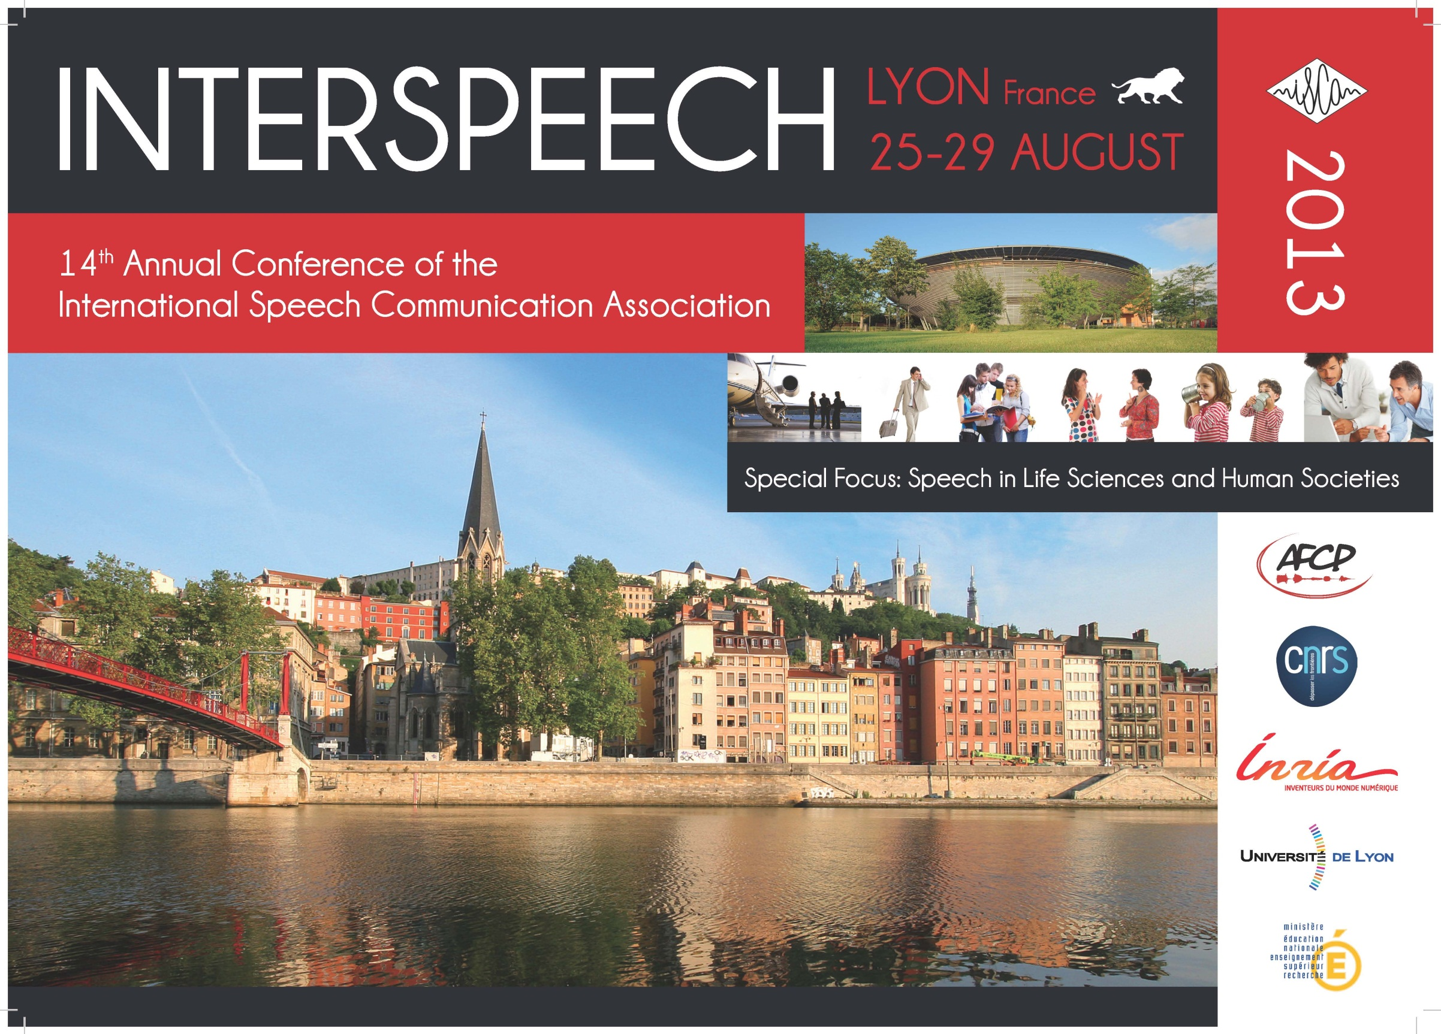

Slide 28


Slide 29

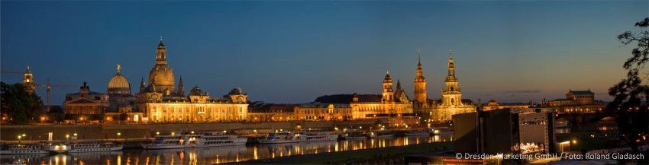
INTERSPEECH 2015
September 6-10, 2015, Dresden, Germany
Special Topic: Speech beyond Speech:
Towards a Better Understanding of the Most Important Biosignal
www.interspeech2015.org

Slide 30
Approval of Reports
Report
  President
  Treasurer

Slide 31
Discussion:
Future of ISCA and
ISCA goals for 2012-2013

Slide 32
Why ISCA?
ISCA was launched in order to serve the speech communication research community
Founders thought that such an association was missing!!!
  In terms of scientific area (have an association focused on speech, only)
  In terms of activities
  In terms of « spirit » or « way of life »
ISCA was not launched in order to duplicate an existing association
-> ISCA « raison d’être » was to complement existing societies

Slide 33
ISCA current situation
ISCA still has an unique position in the community
ISCA represents the largest group of speech communication researchers
ISCA administrative/permanent staff = Manu!!
ISCA is in a good financial situation
  But it is mainly linked to the previous point: light administrative structure
ISCA provides a small set of strong services
  But it will be difficult to develop more services

Slide 34
ISCA current situation: conclusions
ISCA administrative structure should remain as it is
But with the use of external services for “basic” stuff
The board members, volunteers, have important duties when it is more and more difficult to find time…
  A better/adapted internal organisation is needed
  Two levels organization (topic committees and reduced size virtual board meetings)
ISCA can’t do everything…
  Select the best services ISCA could give to the community
  Work more in cooperation with other societies

Slide 35
ISCA Goals for 2012-2013 (1)
Continued effort for
  Interspeech (scientific quality, affordable registration fees…)
  ISCA Archive and referencing
  SAC activities
  …
More effort towards young/future speech researchers
  Grants, DL, ISCA Training School, Training resources
More emphasis on areas where ISCA could have a large impact
  E.g., preservation of endangered languages

Slide 36
ISCA Goals for 2012-2013 (2)
ISCA and social networks: a tentative!
  Facebook ISCA official page just launched
  https://www.facebook.com/iscaspeech
  With the help of Maxine Eskenazi
  (please, click on “like”!!)
  Extension, soon to LinkedIn, Twitter…
  Reflexion on how to use this stuff
    Better communication of ISCA news (highlights)
    Reinforce the relationship between group of members
    Improve the interaction during/after IS between presenters and participants

Slide 37
ISCA future: technical authority for society?
Metrics for researcher evaluation
Be a source of information or experts for the different authorities or media
Be a source of advice/expertise for all questions around our area (health, security and privacy, standards, funding programs…)
Take part in international debates like
  Forensic voice authentication
  Lie detection
  Voice piracy

Slide 38
ISCA next future!!
2013 ISCA BOARD ELECTIONS
9 members (out of 14) will finish their terms in 2013
(for 4 of them, it is the second and last term)
A maximum of three Board members from any single country
Nominations can be made by the Board and by each ISCA member (3 ISCA member nominations are needed)
Elections will take place in April/May 2013
The call for nomination will be launched in the begin of 2013

Slide 39
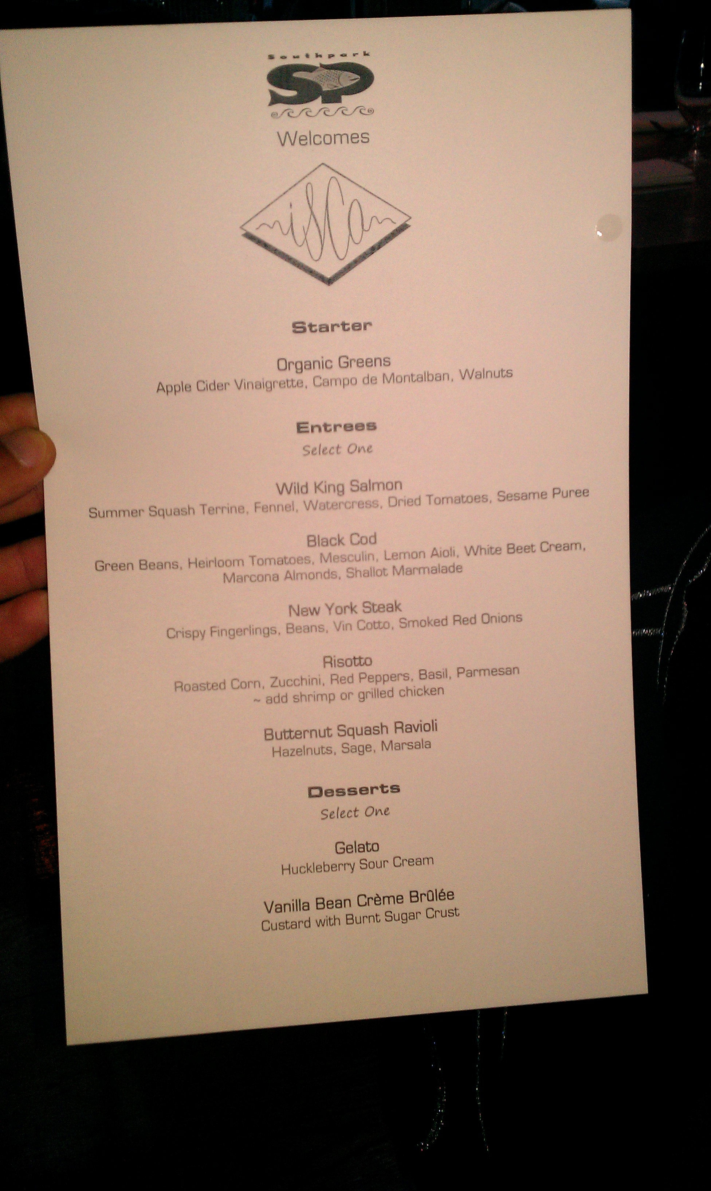
ISCA next future!!
2013 ISCA BOARD ELECTIONS
Becoming a board member, will bring to you big rewards!!
One free dinner per year
with
great people!

Slide 40
Comments, Suggestions and Questions from ISCA Members

Slide 41
Next ISCA General Assembly
INTERSPEECH 2013
Lyon, France. August 25-29, 2013

